Slide 1
KMOU Division of Marine System Engineering
Introduction to
Internal Combustion Engine

Slide 2
Introduction to part-time lecturer (Minho Park)
EDUCATION
2014: B.A., Marine system engineering, National Korea Maritime and Ocean University, Busan
2023: M.S., Marine engineering, National Korea Maritime and Ocean University, Busan
2025: Ph.D., Marine engineering, National Korea Maritime and Ocean University, Busan
POSITIONS
2012: Marine engineer (Final position: Apprentice engineer), Hanjin Shipping
2014-2018: Marine engineer (Final position: 2nd engineer officer), H-Line Shipping
2019-2020: Marine engineer (Final position: 1st engineer officer), G-marine service
2021-2025: Researcher, National Korea Maritime and Ocean University
2025-date: Postdoctoral Fellow (BK21 Four), National Korea Maritime and Ocean University

Slide 3
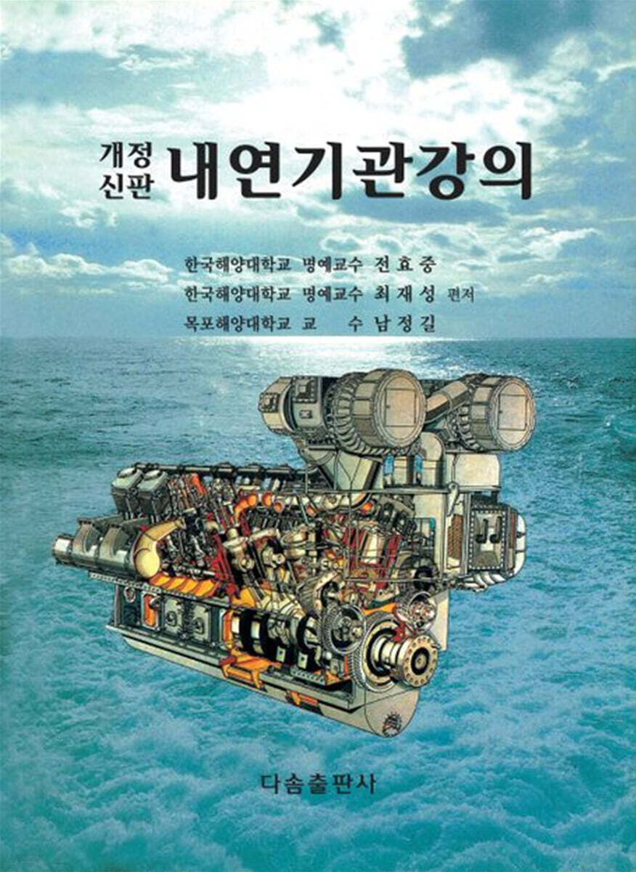
How classes are run
Classes will be mainly operated with PowerPoint files.
Textbook is just for reference (not mandatory).
PPT files are mostly written in English.
(I am not native English speaker, so the grammar is not perfect.)
15 weeks course, so 13 PPT files are prepared. (Excluding midterm and final exams)

Slide 4
Why are the course materials in English?
1) Most of the students here end up working as marine engineers on ships.
2) As a marine engineer, you will operate and maintain several machinery.
3) Every ship has an instruction book (manual) for each machinery.
4) Most of the machinery on the ship are foreign products, not domestic (S. Korea) ones, so instruction books are in English.
5) To understand (operation and maintenance) each machinery, you must read instruction books.
6) When you get a job, you will be taught using the company's training materials. These training materials are either copied from parts of the instruction books or are based on the instruction books.
7) Therefore, English is important, and through lectures, you will learn in advance the terminology used in internal combustion engines.
8) Moreover, to work with foreign crew members, you must be able to speak English and know the terminology used in each machinery.
9) Reading materials in English can indirectly improve your TOEIC reading skills.

Slide 5
Lesson content for each week
Ch0_Introduction to the Class | Ch6_Piston Fittings and Crankshaft
Ch1_Overview of the Internal Combustion Engine | Ch7_Lube Oil System
Ch2_Thermodynamics and Compressed Air System | Ch8_Cooling Water System
Ch3_Marine Fuels and Internal Fuel Oil System | Ch9_Introduction to the Main Engine
Ch4_Intake and Exhaust System | Ch10_Alternative Fuels and Alternative Fuel Systems
Ch5_Turbocharger | Ch11_Environmental Regulations and Exhaust Gas Aftertreatment Systems
Midterm | Ch12_Tools, Apprentice Engineer Duties, and Career Direction
 | Final Exam

Slide 6
Grading method for this class
Midterm exam: 45%
Final exam: 45%
Attendance: 10%
All course materials have been uploaded to GitHub, so please download them.
GitHub address: https://github.com/MHPARK777/Internal-Combustion-Engine

Slide 7
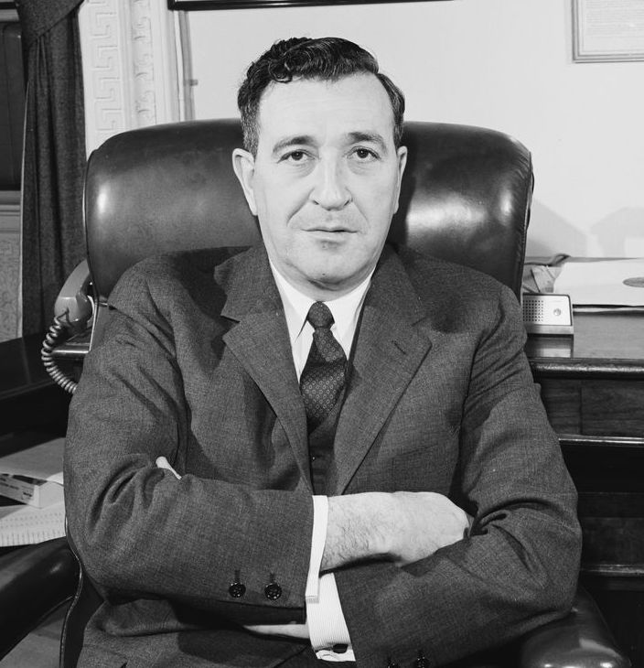
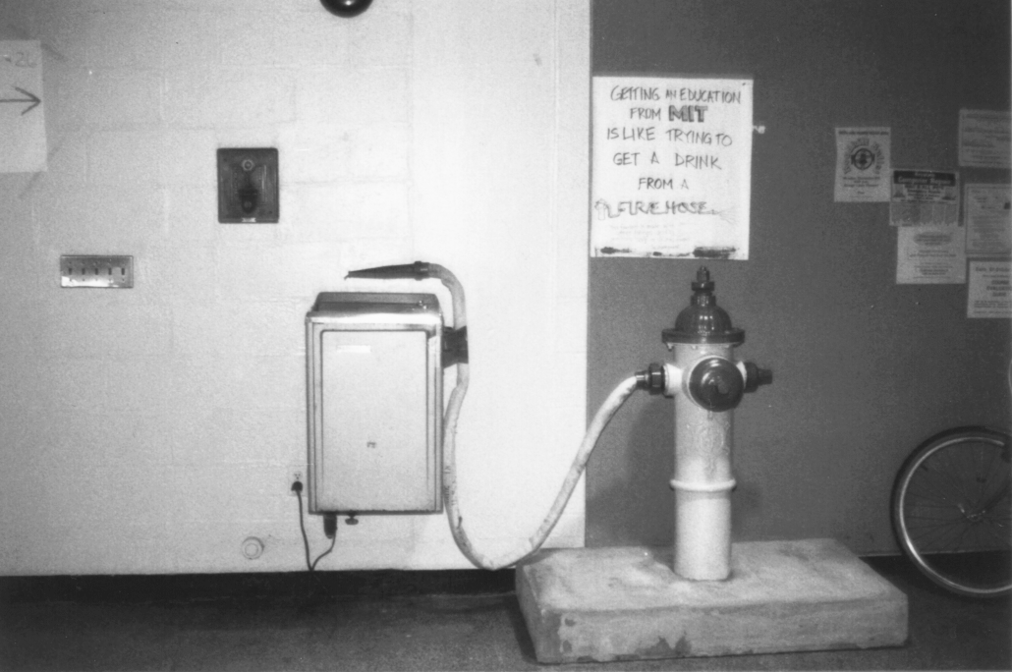


Motivation
What getting an education from MIT is like?
The famous quote widely attribute to former MIT President Jerome Wiesner: “Getting an education from MIT is like taking a drink from a firehose.”
(1915-1994)

Slide 8
References
1) https://en.wikipedia.org/wiki/Jerome_Wiesner
2) https://mitadmissions.org/blogs/entry/getting-an-education-from-mit/
3) https://www.mit.edu/
4) https://www.frontiersin.org/about/institutional-partnership/massachusetts-institute-technology-mit

